Slide 1
Optimized Decision Making using AI and Constraint Programming
Helmut Simonis, Insight Centre for Data Anaytics,
School of Computer Science and Information Technology

Slide 2
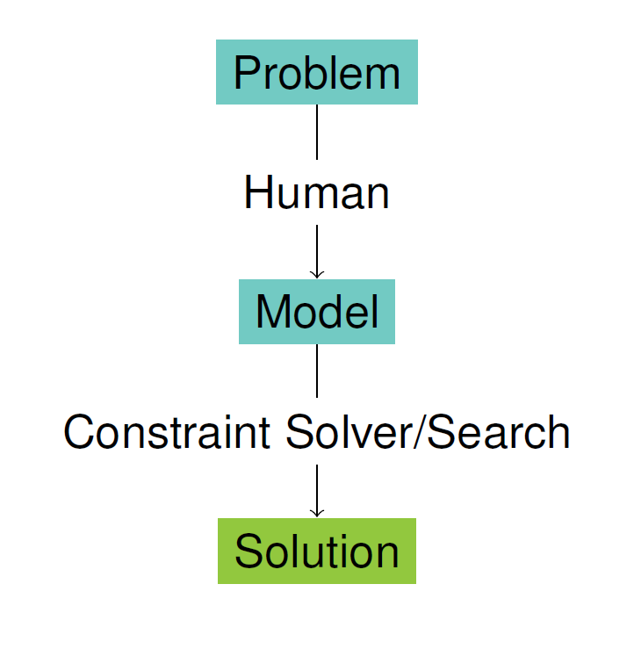
AI is more than ChatGPT
Enterprises need tools that are
Flexible
Reliable
Explainable
Constraint Programming provides basis for such tools
Research focus at UCC for 25 years
Flexible interaction with industry
Presenting some examples

Slide 3
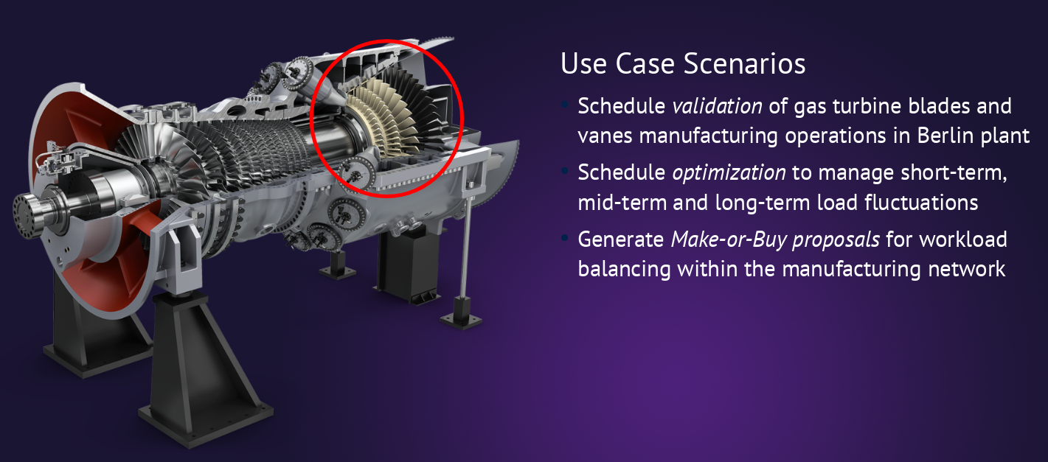
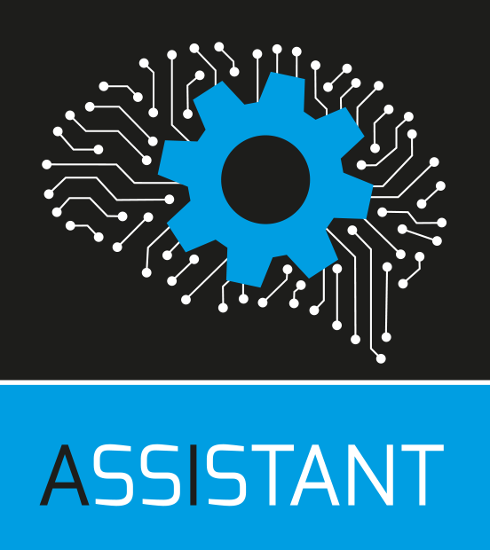
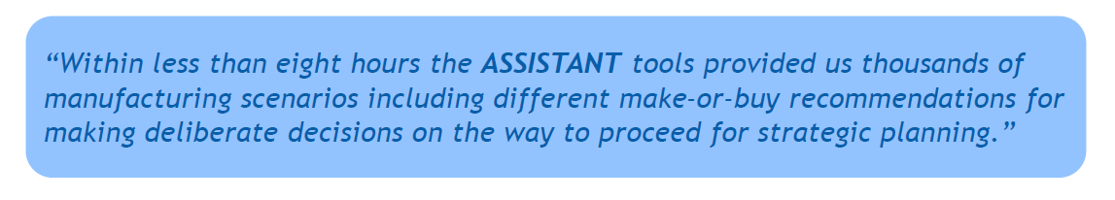
ASSISTANT European Project
Use AI to improve decision making in manufacturing
Siemens Energy Use Case
Gas Turbine Manufacturing
Guaranteeing on-time delivery
Using large-scale CP solution

Slide 4
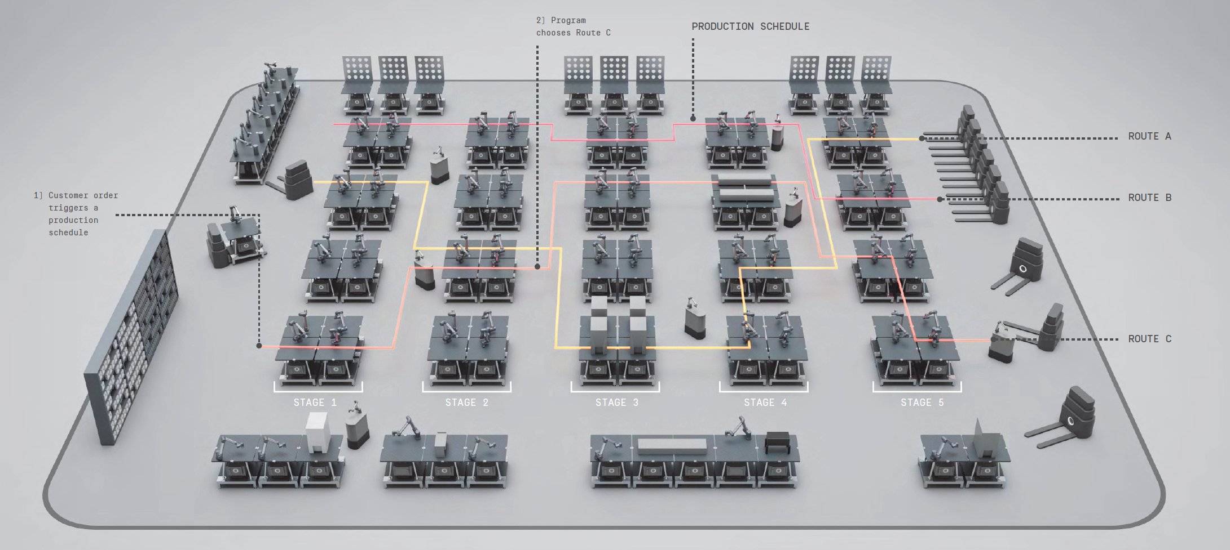


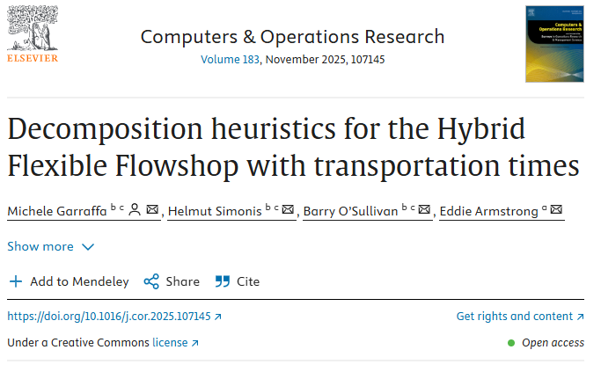
Exploring Novel Concepts with Industry
Project with
Explore new manufacturing environment
Robots, flexible workstations
Semi-custom products
Basic research challenge
How to solve this type of scheduling problem
Which approach works best
Research output

Slide 5
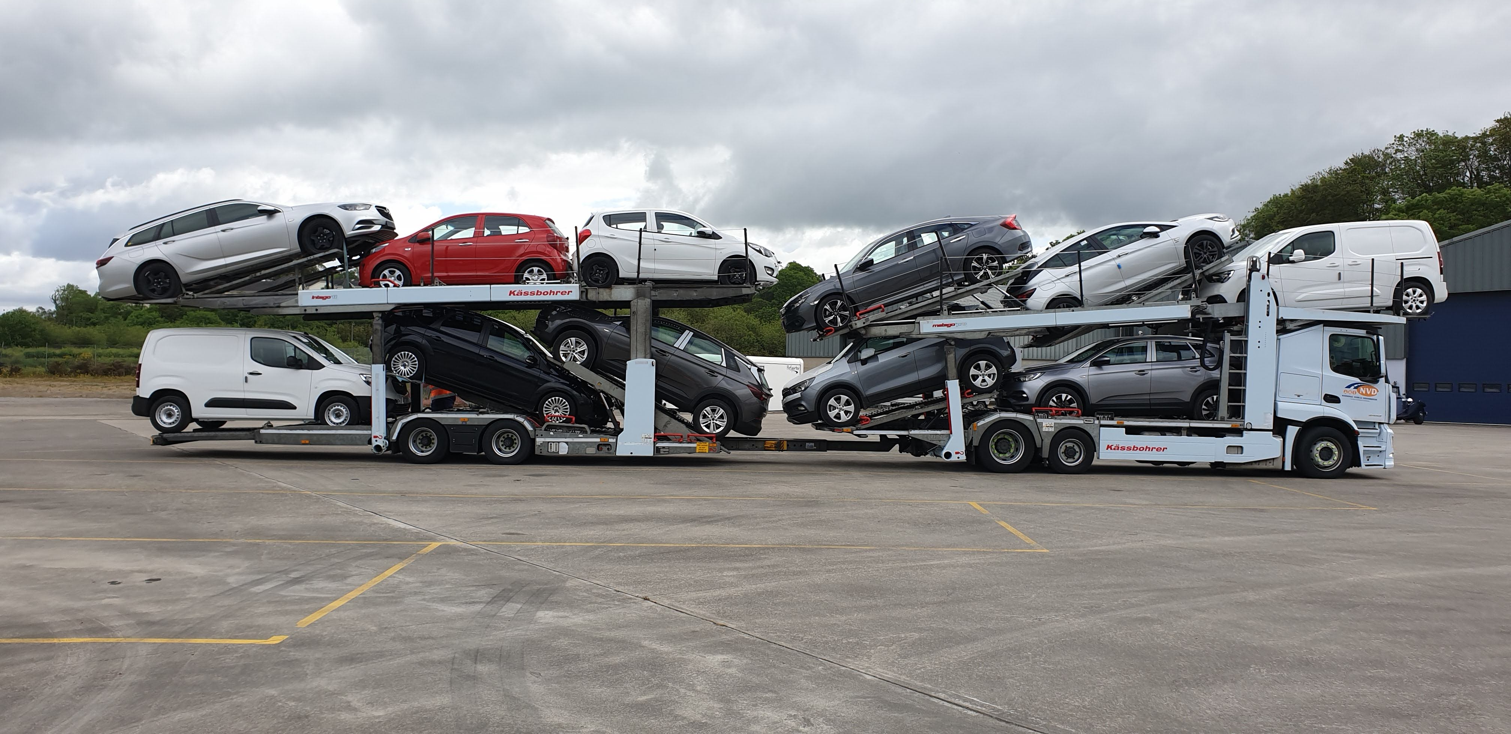

Car Transport with NVD
Deliver cars from Ports/Factories to dealers
Complex, non-standard transportation problem
Process
Understand problem
Explore solution alternatives
Provide experimental solution
Handover for productization and daily operation

Slide 6

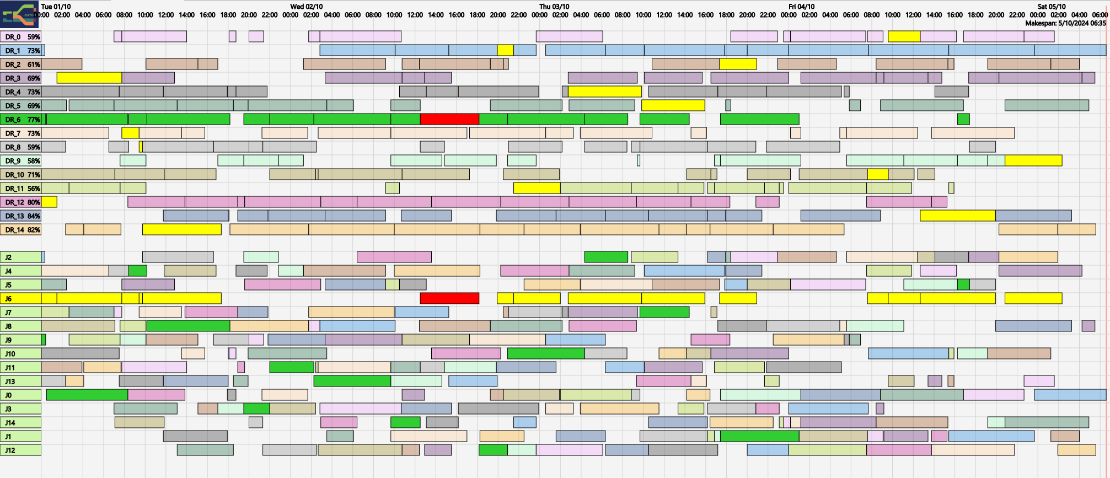
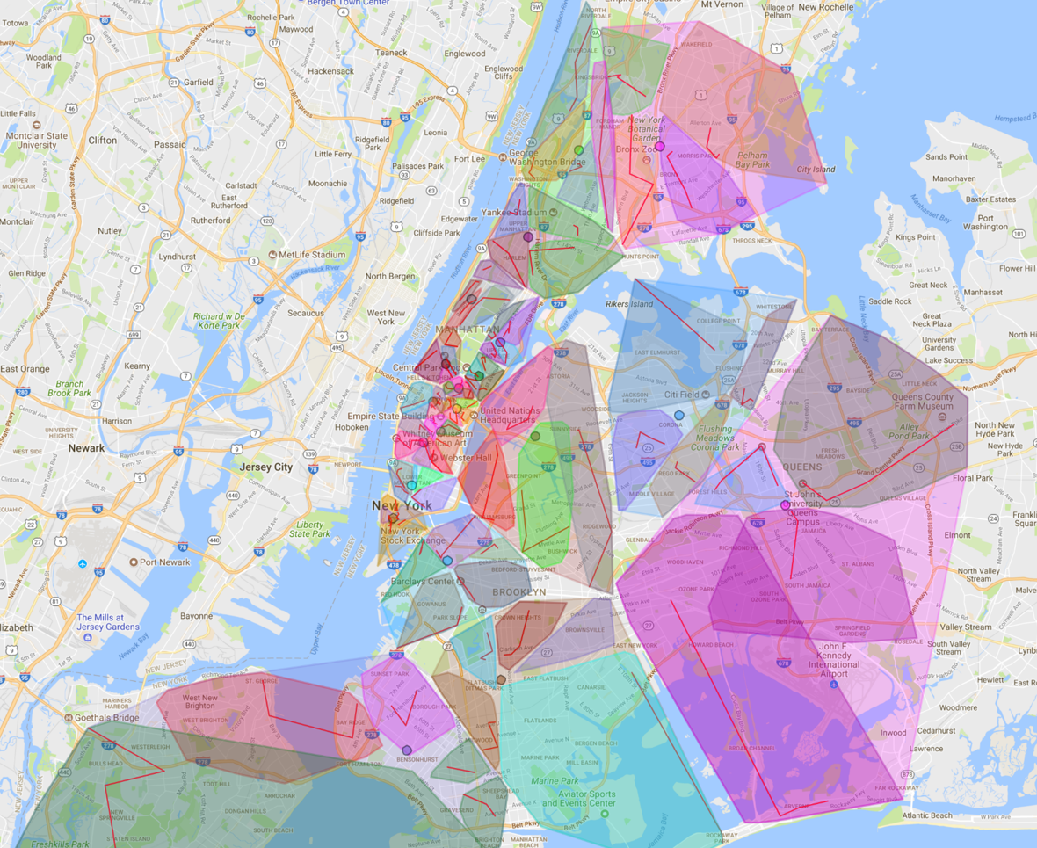
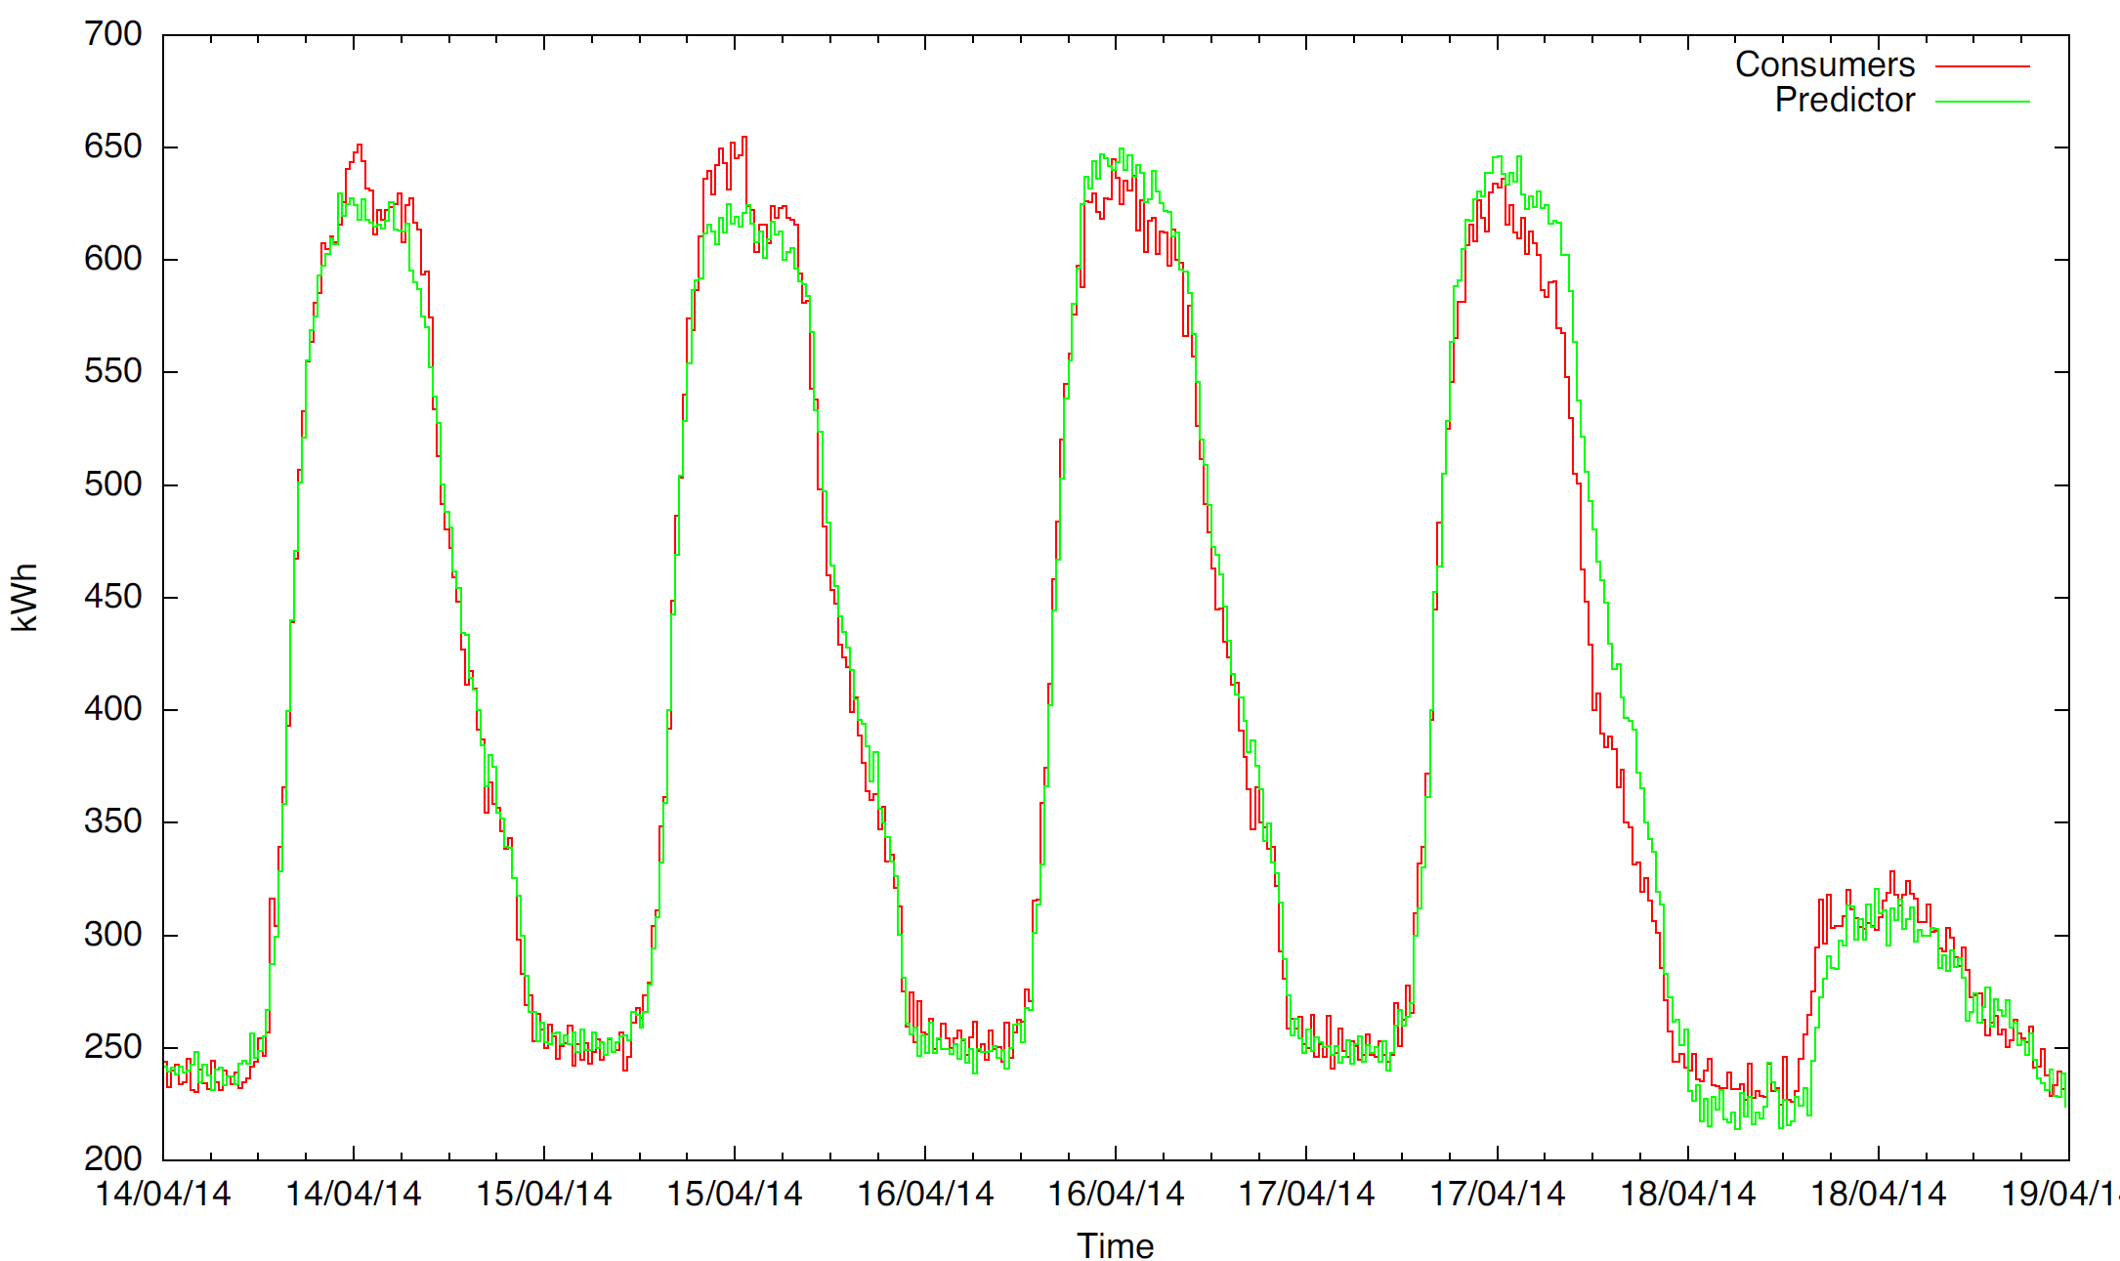
ENTIRE EDIH (European/Enterprise Ireland)
Digital Innovation Hubs
Provide training and upskilling for SMEs and PSO
AI Fundamentals Courses
Using Constraint Programming in different application domains
Scheduling
Rostering and Timetabling
Energy Cost Optimization

Slide 7
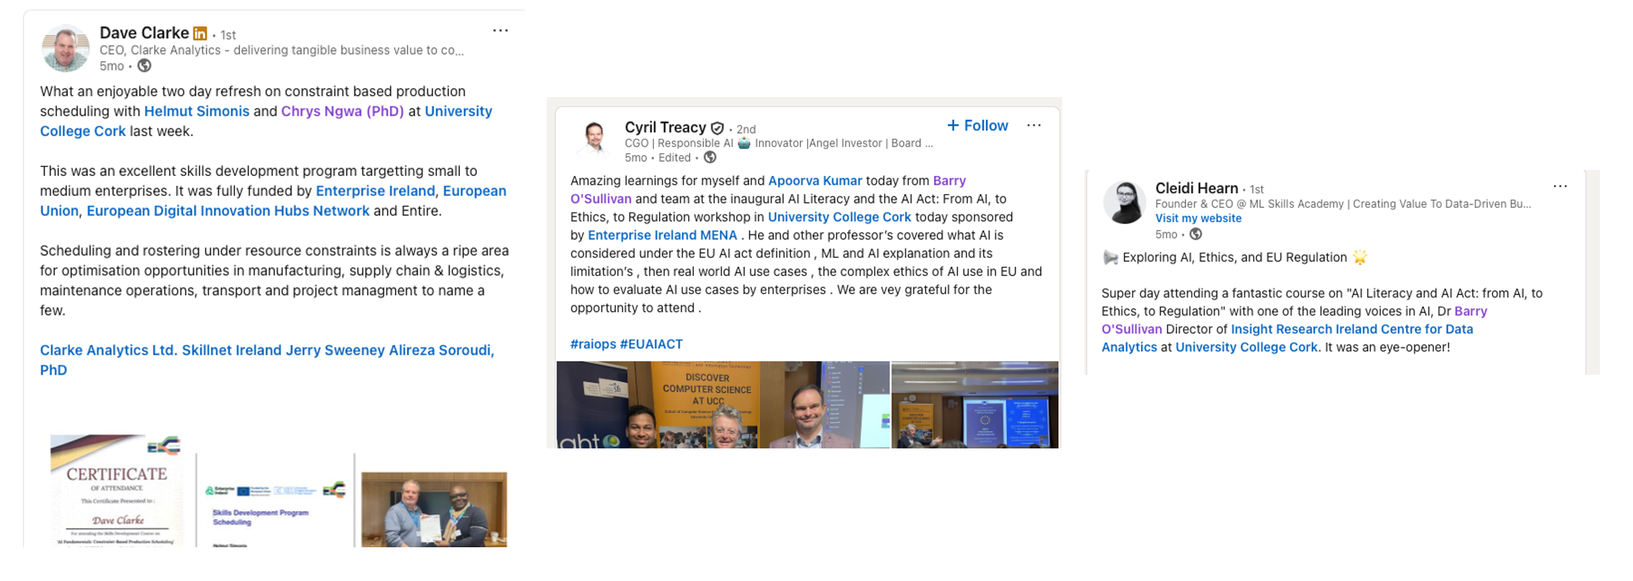
Testimonials from Participants

